Slide 1
BFRMO Observatory
Basics Class
Westminster Astronomical Society
Steve Conard
15 February 2020

Slide 2
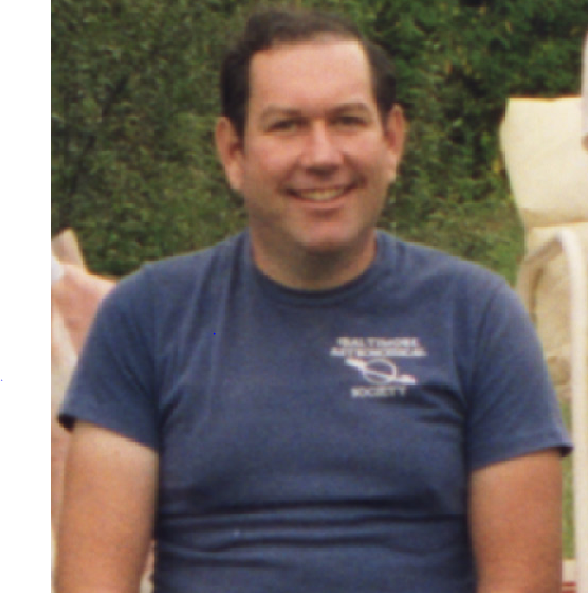
Blaine F. Roelke Memorial Observatory
Blaine Franklin Roelke (1946-2013)
WASI Charter member since 1984

Slide 3
Goals
Get most of you nearly ready to perform basic operations at the observatory
  Most, if not all of you, will require more hands-on practice prior to doing your skills demonstration
You should be able to:
  Plan you observing session
  Access the observatory
  Open, close, and rotate the dome
  Power up, move the telescope to basic targets, and hibernate the telescope
  React properly to off-nominal situations
We won’t be covering
  Making adjustments to the telescope and mount
  Astrophotography related issues

Slide 4
Important!
Significantly less than half of those who take this class ever take the practical test to get their “driver’s license”
Please take responsibility for your own further training
  While I will occasionally schedule practice nights, more often than not you will have to request practice time
  You will also have to contact me to schedule your practical test
  Please don’t depend on me for these--please ask!
If the observatory is being used for club observing or public outreach, you may be able to get some informal practice time—but understand that is not the priority for these sessions
  When other members are using the observatory for their interests, you can ask if you can watch or help them operate, but understand this may conflict with their goals

Slide 5
Agenda—Part 1
Telescope basics
Getting around the sky
Logistics for observatory use
Your observing session

Slide 6
Agenda-Part 2
We will all go to the observatory when it is still light out
  Must NOT be raining to do this part, but needn’t be clear
We will go through everything you may want to use, while it is light enough to see things
  This is another great opportunity to ask questions
We will go through opening/closing the dome, rotating the dome, prepping the telescope, and operating the telescope
  Everyone gets some hands-on time
Once complete, those of you not doing individual skills demonstrations can leave

Slide 7
Skills Demonstration
Qualification for each individual
  30 to 60 minutes per person
  Must be partly cloudy or better to do this part
You will
  Show you know how to work the dome
  Start telescope from hibernation
  Find a couple of objects on the sky
  Hibernate the telescope
  Close up for night

Slide 8
General Telescope Basics

Slide 9
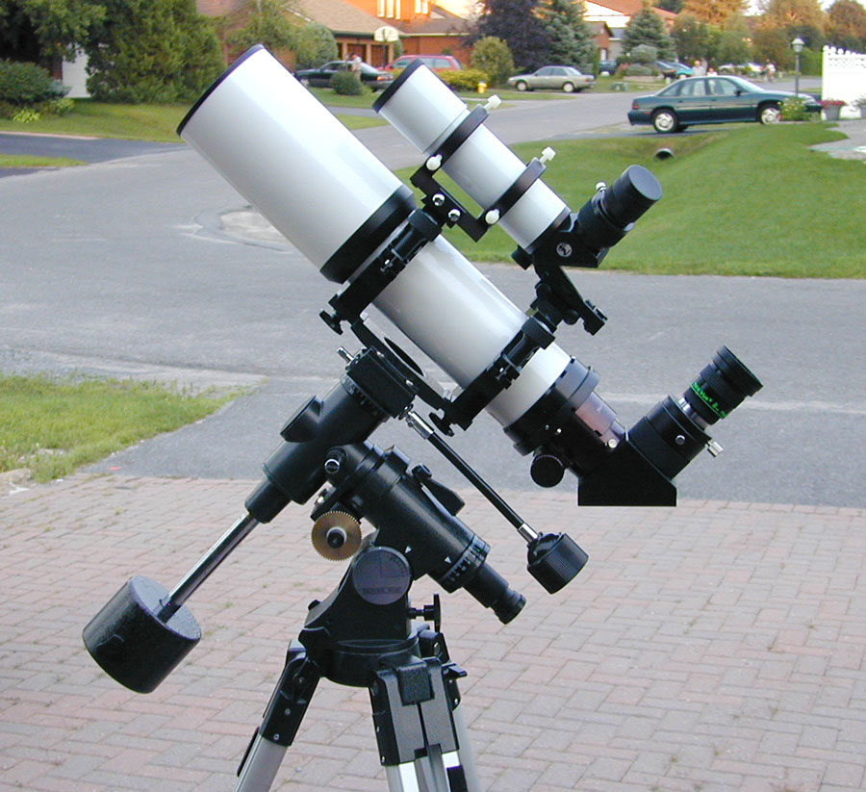
Parts of a Telescope
Finder
Telescope = everything!
  Or telescope = tube
  Tube = “OTA”
Eyepiece
Diagonal
Mount
Tripod (or Pier)
Credit: https://themcdonalds.net/richard/wp/balancing-an-equatorial-mount/

Slide 10
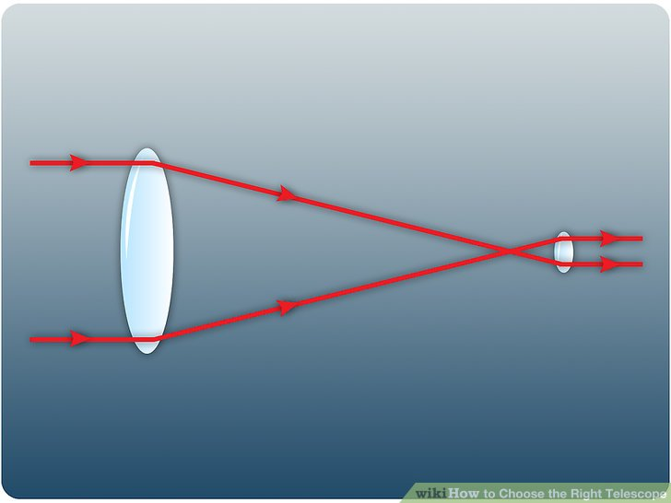
Aperture and Focal Length
Aperture = diameter of first lens or mirror surface
  Generally in inches if large and mm if small
  The big telescope is 14”, the small is 81 mm
  Larger aperture will give brighter images for all objects, assuming the same focal length
Focal length = how far behind the aperture (“entrance pupil”) does the image come into focus (sort of)
  Generally in mm
  Longer focal length = higher power
Aperture
Focal Length

Slide 11
Focal Ratio
Focal ratio (or f/#) = focal length / aperture
  “Camera” people (aka “Jackie”) will ask about this
  Unitless
  “Fast” = low numbers (say ~3.5 to 6), “slow” = high numbers (~10 to 15)
  Fast generally will have brighter images for extended objects
f# = f / d
d
f
Big telescope is f/11 (slow) Small telescope is f/6 (medium to fast)

Slide 12
Power
Power = focal length of the telescope divided by focal length of the eyepiece
Power is unitless
Power is a measure of how much larger something appears while viewing it through an optical instrument
Example—what power is required for Mars to appear “as big as the moon” at the last opposition?
  P = 31’ / 0.40’ = 77 x
P = f_{t} / f_{e}
f_{eyepiece}
f_{telescope}
Eyepiece | Big Scope 4000 mm | Small Scope 480 mm
50 mm | 80 x | 10 x
30 mm | 133 x | 16 x
20 mm | 200 x | 24 x

Slide 13
Field of View
FOV = FOV_{apparent} / Power
Field of view is the actual angle on the sky you can see through an optical instrument
  Want to match this roughly to the size of the object you are looking at
  Angular units (typically degrees or arcminutes—1/60 of a degree)
  Example—if you want to see all of the moon through the big scope
    Moon is ~32 arcmin, so the 50 mm eyepiece would be required to fit it all in
  This is why we have a small telescope—to show bigger objects, such as star clusters
α
Eyepiece | Apparent Field of View | Big Scope 4000 mm | Small Scope 480 mm
50 mm | 60° | 45 arcmin | 6°
30 mm | 68° | 30 arcmin | 4.2°
20 mm | 68° | 20 arcmin | 3.4°

Slide 14
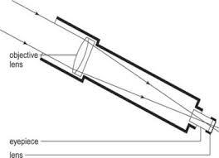
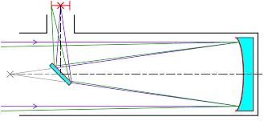
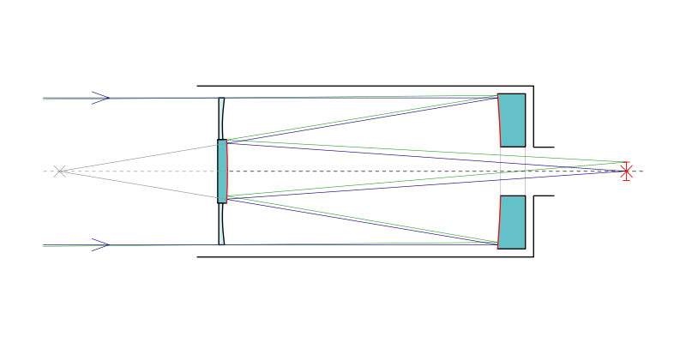
Telescope Types
Refractors
  Focusing lenses
  The smaller telescope and finder are this type
Reflectors
  Focusing mirror(s)
Catadioptrics
  Combination of lenses and mirrors
  The big telescope is this type
Credit mrclarkrbhs.wikispaces.com
Credit pieceofsky.wordpress.com

Slide 15
Getting Around the Sky

Slide 16
Sky Coordinates
Right Ascension (“RA”, similar to Longitude)
  Runs 0 to 24 hours, increasing to the west
  Each hour is subdivided into 60 minutes, which in turn are divided into 60 seconds
    Angular distance of hours/min/sec varies with declination!
  The earth rotates in this fixed coordinate system about 24:04 RA in 24 hours time
    The same point of the sky will be at the same altitude/azimuth about 4 minutes time earlier each night
Declination (“Dec”, similar to Latitude)
  Runs -90° to + 90° south to north
  Each degree is subdivided into 60 minutes, which in turn are divided into 60 seconds
    Angular distance of degrees/min/sec is invariant
    RA min/sec ≠ Dec min/sec!
RA and Dec are fixed to the sky
This is how we specify the location of targets on the sky, for input to the telescope mount

Slide 17
Sky Coordinates
Altitude (elevation) is angle above the horizon, and is fixed by your location on the earth
  Measured in degrees-minutes-seconds, but for amateur astronomy we generally only care to the degree level--runs from 0° to 90°
Azimuth is angle from north, measured along the horizon line from your location
    Measured in degrees-minutes-seconds, but again we generally only care to the degree level--runs from 0° to 360° looking clockwise from above
    Beware what north you are referencing (true, magnetic, grid)—they can vary significantly—astronomers use true
  Altitude/azimuth are generally used to tell where an object is in your local coordinates
    Is the object too low to the horizon to be seen from our observatory (altitude)?
    Is the object going to be behind that tree (altitude and azimuth)?

Slide 18
Sidereal Time
Sidereal time is actually just the RA that is crossing your meridian at that time
  The meridian is an imaginary line that runs across the sky from north to south
  Splits the sky into an east and west hemisphere
Since for our telescope’s equatorial mount it is important what is in the east and west, knowing the local sidereal time makes it a snap to know
  If it has a lower RA than the local sidereal time, the object is in the west, higher to the east
    Applies up to angular distances of 12 hours

Slide 19
Sidereal Time (continued)
How can you tell sidereal time?
  Look it up on the internet: http://tycho.usno.navy.mil/sidereal.html
    You’ll need to know your longitude
    Roelke Observatory: Lat +39° 38’ 50”, Long -76° 59’ 11”
  Get a sidereal clock
  Get a sidereal clock app for your smart phone
    I use “MySiderealTime” app for Android
    This also gives you local time to the second, that will help when you need to tweak the mount’s time

Slide 20
At Roelke Observatory
Almost everything you find will be by doing a direct Go-To
  The key is to know how the object is named in the telescope
  Some objects are by name, others by number

Slide 21
Solar System Object Names
Major solar system objects just go by name, picked off the menu—”Planets” or the 5 key
  Included are all non-dwarf planets plus Pluto
  The moon and sun
  Asteroids and comets are not included, you’ll have to get your own RA/Dec for the time you’ll be looking for them and program those coordinates into the mount

Slide 22
Stars and Patterns
  Stars
    Star or 5 key: SAO (Smithsonian Astrophysical Observatory) numbers—generally a 6-digit number—leading 0’s not required
    List or 8 key→named stars: proper names (bright stars only, maybe as faint as mag 3), scroll up or down to name
  Double stars and variable stars
    List or 8 key→double stars/variable stars: by proper name, constellation Greek letters, or catalog #, scroll up or down to name
  Constellations and asterisms
    List or 8 key→constellation/asterisms: by name, scroll up or down

Slide 23
Deep Sky Objects
  Clusters, nebula, galaxies
    Messier or 1 key: Messier number (bright objects), must include leading zero if less than 100
    Cadwell or 2 key: Caldwell number (other bright objects)
    NGC or 4 key: NGC number (other objects)
    List or 8 key→ object name (bright objects), scroll up/down to object

Slide 24
User Objects
You can also get to objects by either:
  Directly entering RA and Dec into the hand controller
  Saving RA and Dec as a user object, and slewing to it at some later time
Only time you are likely to use this is for some transient object, such as a nova or comet

Slide 25
Planning Observations
Questions to answer first…
  When does your target cross the meridian?
  When is your potential target above the effective horizon?
    Is your target faint or something requiring high power? If so, you’ll want to observe it as high in the sky as possible
  What elevation is your target when you’ll observe it?

Slide 26
Crossing the Meridian
When does the target cross from the east to the west celestial hemisphere?
  Why important: highest elevation, meridian flip issues
Check your planetarium program for your observing day
Quick estimate on same day:
  Calculate hours to observation time
  Add this to the current sidereal time
    If > 24, subtract 24
    This is the observation time’s sidereal time
  Compare this to the target’s RA
    If target > sidereal time, the difference is hours until meridian crossing
    If target < sidereal time, the difference is hours after crossing
    Correct for 24 hour roll-over!

Slide 27
Above the Effective Horizon
Reasonable to assume >20º elevation
  Accounts for trees, buildings, lighting, etc.
Best way—use your planetarium program set to your possible observing times
Quick estimations
  Declination >70º, always visible
  50º < Dec < 70º, +/- 7 hours from meridian crossing
  30º < Dec < 50º, +/- 6 hours
  10º < Dec < 30º, +/- 5 hours
  -10º < Dec < 10º, +/- 3.5 hours
  -30º < Dec < -10º, +/- 1 hours
  Declination < -30º, never!

Slide 28
Elevation of Target When Observed
Keep ~60º in mind
  How you open observatory slot depends on this!
Best way—use your planetarium program set to your possible observing times
Quick estimations
  Declination >70º, never above 60º
  50º < Dec < 70º, +/- 2 hours from meridian crossing
  30º < Dec < 50º, +/- 2.5 hours
  10º < Dec < 30º, +/- 1.5 hours
  Declination < 10º, never above 60º

Slide 29
Tonight’s Examples
Venus
  RA 00h 34m, Dec 3º 44’
  Sidereal time at 5 pm is about 2:30, observing at 6:30 pm
  Sidereal time when observing ~4:00
  RA is lower than Sidereal time—Venus has crossed the meridian about 3.5 hours earlier
  For this Dec, should be right about 20º above horizon—use low slit configuration and down wait much longer than this to see it
M42
  RA 05h 36m, Dec -5º 26’
  Sidereal time at 5 pm is about 2:30, observing at 7:00 pm
  Sidereal time when observing ~4:30
  RA is higher than Sidereal time—M42 will crossed the meridian about 1 hour later
    Good time to observe it!
  For this Dec, should be well above the horizon, but not near our 60º limit.
  But close to a meridian flip for the mount

Slide 30
Logistics for Observatory Use

Slide 31
Basic Rules for Use
Follow proper sign-up procedure each time
Leave everything in better shape than you found it
It is fine to bring in food and drinks, but take everything and all trash with you when you leave
No smoking in and around the observatory, no alcohol on BBNC grounds
  Follow all BBNC rules at all times!
Only perform observatory operations that you are qualified to do, take the training classes
If you use it, please come to the club work-sessions to keep things in tip-top condition, and occasionally volunteer for public nights
If you break something that isn’t usual “wear and tear”, you will be expected to replace it

Slide 32
Emergencies
Most emergency situations should be handled by common sense
  People first, then things
An emergency contact list is provided in the manual
Emergency Contact List
Fire, Medical Emergency, Police: Dial 911
Problem directly related to BBNC building or grounds
_______________________________
_______________________________
Problem directly related to BFRMO:
Steve Conard
410-795-0527 (home)
410-227-7663 (cell)
steve.conard@comcast.net
Curt Roelle
443-340-7895
roelle1@yahoo.com

Slide 33
Severe Weather
Severe weather instructions are also provided in the beginning of the manual
Severe Weather Instructions
In the event of the following:
  Audible thunder
  Precipitation
  High wind
  Weather warnings (not watches) involving extreme weather
Immediately cover the aperture of the telescope
Rotate the dome such that the slit is away from the direction the wind is blowing
Close the dome slit
Then go about the other normal shut-down activities for the observatory
For thunderstorms, you may be safer inside your car than in the observatory
Report any noted damage to the observatory director later
Always use your best judgment for issues involving personal safety (people first, than "things")!

Slide 34
Qualifications to Use BFRMO
Two classes of operators
  Basic: Turns on telescope from hibernation, makes no adjustments (other than finder to scope adjustment), can’t operate for solar viewing
  Advanced: Can align/realign the telescope from scratch, can balance the telescope, can adjust polar alignment (only with permission of OD), can adjust collimation of telescope (only with permission of OD)
You must take the class for basic operation (today’s class!)
  Demonstration of observatory operation (limited to ~4 trainees at a time)
  Practical test of your ability to operate the dome (individually—you can use your notes, manuals, etc.), please refrain from assisting if you are in the dome while someone is demonstrating their skills
  Additionally, we’d like trainees to operate the observatory with another experienced member once before operating solo if possible
Advanced operators must demonstrate their skills after a significant number of observing sessions

Slide 35
Use Agreement
The club may decide to require users of the BFRMO to sign a usage agreement
If we do this, I expect that it will just have you acknowledge that you are aware of the rules for its use, and you agree to follow them
  Most importantly, if you or your guests cause damage to the observatory that isn’t normal wear, the club will expect you to repair or replace the hardware back to the original condition

Slide 36
Reserving the Observatory
Advance sign-up is required for observatory use
  Both the observatory director (OD) and BBNC must be notified and give the OK at least 24 hours prior to use (the OD will contact BBNC for you, so we only have a single point of contact)
    Procedure: Email me at steve.conard@comcast.net , I will contact the folks at BBNC
    Tell me what night you want to observe, give a back-up weather date if you have one
    You must get a positive acknowledgement to use the observatory—no answer isn’t an OK!

Slide 37
Availability
The observatory has become more popular the past year, especially on Friday and Saturday nights
  It is still rare that there is a conflict between uses
  Use by the outdoor school will have priority during the week
  Regularly scheduled public events, whether by BBNC or WASI will have priority
As BBNC is closed Mon-Tue, if you ask me on those days, we may not get an answer until Wednesday

Slide 38
Access
The OD will give you a key code for the lock in advance, if you don’t already have one
  Do not share your code with anyone, codes are only to be given out by the OD
  Codes will occasionally be changed, ask the OD in advance if you were assuming you’d use a code you’ve used before
  WASI members can also get the code to the lock-box holding keys for either BBNC or WASI accessory cases (eyepieces, cameras, etc.)
    BBNC has their own key to the BBNC accessory case (top box) that ODS staff can use
    Please don’t use the BBNC box unless you have a good reason

Slide 39
Your Observing Session

Slide 40
What to Bring
WASI membership card
Eyepieces (there will be some WASI and BBNC eyepieces in the locked storage boxes)
Food/drinks (if you carry it in, carry it out!)
Warm clothes in winter
Cell phone
Red and white flashlights
Spare 2232 battery for red-dot finder, AA batteries for the red light described on the next page

Slide 41
Accessing the Observatory
When you arrive at BBNC, before you do anything else, you must place a red light on the BBNC sign (at bottom of access road) to signal the caretaker that the observatory is occupied.
  This is required for all observatory events, public and private done by WASI
  There will be a red battery-operated lantern in the observatory for this purpose
  Please bring AA batteries for it
  Please return it to the observatory when you leave
  Note—makes life easier if you buy your own, and keep it in your car—just drop it off on the way in and pick it up on your way out

Slide 42
Accessing the Observatory
Enter your four digit code into the lockset
  You should hear it release, open the door
Open the door, go in
  Use caution going in/out, low clearance!
  There are areas inside the observatory with low clearance as well
Light switches are on the left inside the door
  Turn on the red light outside the door and leave it on while the observatory is in use
  Turn on either the white or red lights inside as required
  Please use the inside lights until you are well oriented, avoid bumping the telescope or your head!

Slide 43
Check Hardware/Log In
When you first go in, please take a quick look around
  Look for evidence of vandalism or theft
  Look how the previous user left things
    The telescope should be bagged, pointing to Polaris, and powered off
  Please make note of anything that is amiss—if anything major, please call the OD or BBNC staff ASAP
Start a log sheet to record your activities
  In 3-ring binder on table, usually
A complete instruction sheet will be in the binder as well, plus phone numbers if you have issues
  Check the first page of the instruction binder for recent changes to observatory operations

Slide 44
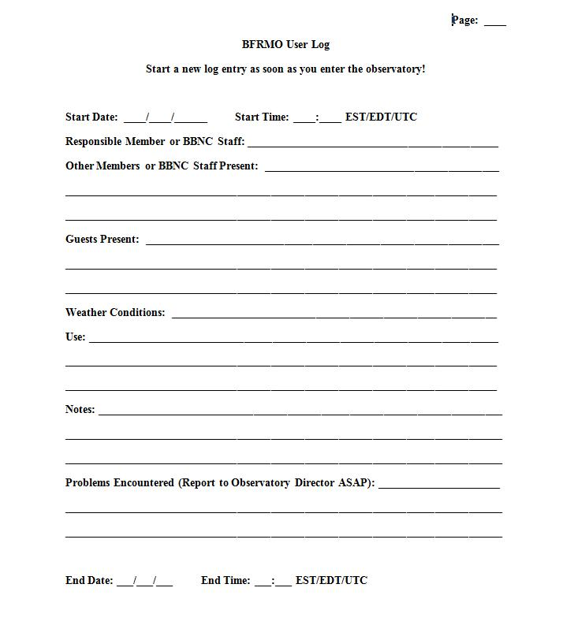
Log Sheet

Slide 45
Dome Operation
Open the observing slit
  Use the cordless drill/hook combination usually laying against the north wall (we’ll hang it up eventually), check chuck tightness
  Standing on the ladder makes this task much easier for the vertically challenged!
  Carefully hook the eyelet on mechanism (do not bump telescope!)
  Run the drill counterclockwise on medium speed until open (takes a while!)
    If going near zenith, pull chain on slit while starting to crank, until top of cover is well clear of bottom
    If going low to horizon, don’t do this
Rotate dome as required using rope tied to handles
  There may be some “soft spots” that require a bit more effort to rotate
Be very careful using the dome if there is significant wind, we’ll try to set gust limits as we get experienced with it

Slide 46
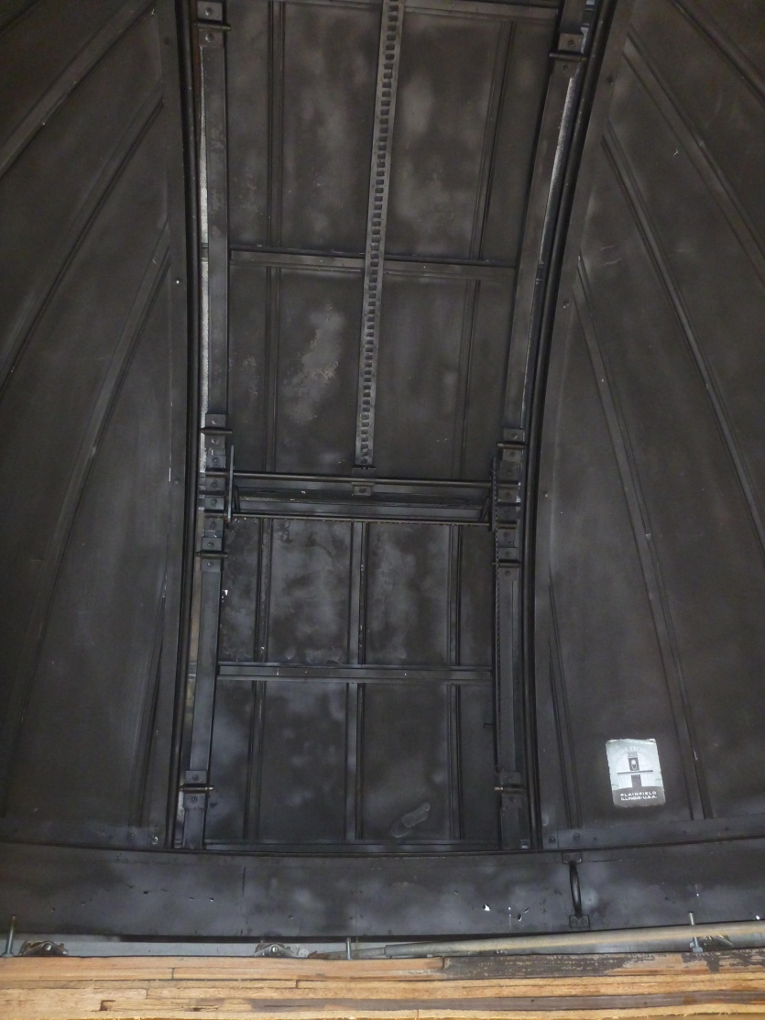
Dome Slit
Upper Slit Cover
Lower Slit Cover Release Chain
Lower Slit Cover

Slide 47
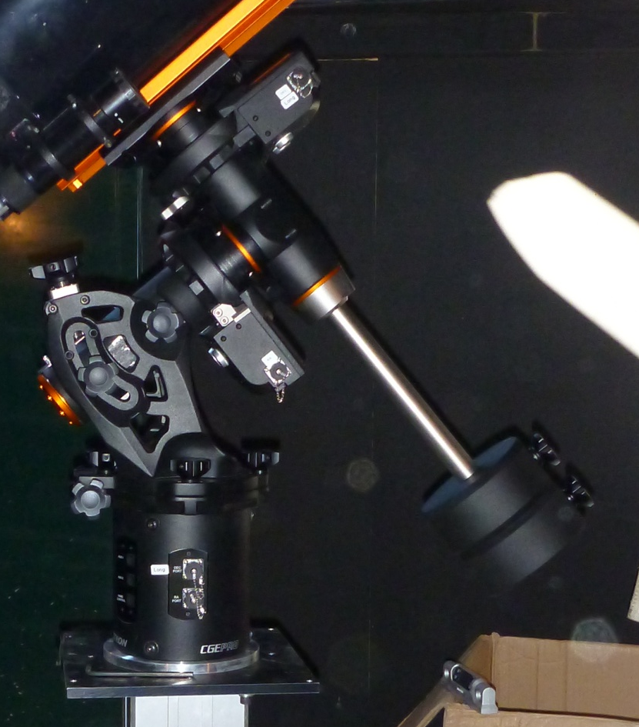
GEM
BFRMO CGE Pro, Shown Pointing to Polaris
Declination Drive
Declination Axis
RA Axis
Polar Alignment Elevation Adjustment
RA Drive
Counter Weight Arm
Polar Alignment Azimuth Adjustment
Counter Weights
Counter Weight Safety Screw
Electronics in Base

Slide 48
Celestron CGE-Pro
This is a moderate-quality go-to mount
Typically you’ll be able to slew to any object, starting from hibernation, and have it within the field of a low power eyepiece (or at least the finder)
  If not, the most typical problems are either entering in the wrong time (make sure you put in time to the nearest minute—local EST) or the telescope was previously hibernated incorrectly
When centering up objects, slow the slew rate to 4 to 6 depending on the focal length of the eyepiece being used

Slide 49
Issue Specific to CGE-Pro
Buttons wear, and sometimes will not register on first push—especially in cold conditions
Display can be hard to read in cold conditions when it scrolls
Connector on hand controller interface to mount is fragile
Menus are complex, and it is difficult to find some of the functions

Slide 50
Issue Specific to CGE-Pro
It cannot be far off balance, and still properly slew
If it starts to slew in a bad direction for any reason, press any of the arrow keys to stop it
If while on a list of objects you press the menu key, the list will be limited to objects in the east or west
  Indicated by the E or W in the upper right of the display
  Press the menu key once or twice to make the E or W disappear

Slide 51
The Pier-Tech Pier
Allows the telescope to be raise about 18”
Please leave at lowest point at end of each session
Raise to:
  Allow taller users to have more comfortable access to the eyepiece
  Reach objects closer to the horizon
The telescope will be aligned at the lowest position, note that minor degradation of alignment occurs when the pier is raised
If it is at bottom, and won’t rise, hold the up button down while lifting the top plate of the pier
  Once it starts moving, let it run on its own

Slide 52
The BFRMO SCT
Is a Celestron “C-14”, and has a focal ratio of f/11, built in the late 1980’s
Focus knob is on back of primary cell, and the primary mirror is moved while focusing
  Also on traditional eyepiece mount
Suffers from “mirror” flop when slewing around, especially after a meridian flip
  Causes alignment change, slight focus change
Note that the most fragile part of the telescope is the corrector plate—please use great care when installing/removing the cover

Slide 53
The BFRMO APO
81 mm, f/6 true APO William Optic
About 3 years old
Good for wide-field viewing
  Large objects, like the entire moon or open star clusters
Also popular for DSLR astrophotography

Slide 54
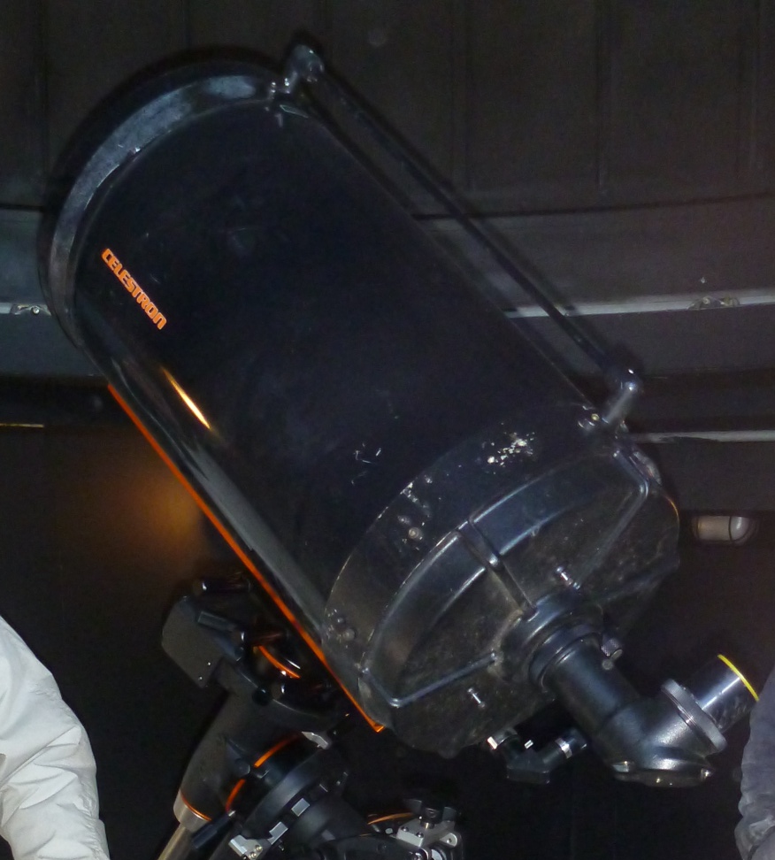
C-14
Declination counterweight bar (counterweights not in place)
Cover
Eventual location of red dot finder
Dovetail
Focus knob
Finder
Diagonal

Slide 55
Instruction and Manuals
There is a binder that has both the simplified basic instructions for BFRMO and the Celestron manual in it
I will try to update the instructions as I can
  If you find mistakes in it, feel free to mark up the version in the binder (put your name and date by the change), and also notify me

Slide 56
Basic Telescope Operation
Take the bag off the telescope
Take the cover off the telescope aperture, install eyepiece
Power on the telescope power supply (under the base of the pier)—pilot light comes on
Power on the GEM using the switch on the electronics base of the mount—pilot light comes on, hand controller lights up
After a few seconds, hand controller should say “press enter to wake”, press enter
The hand controller will ask you to check its time (scroll up/down from the “Baltimore” on the display), if OK, press enter, otherwise edit to be within 30 seconds of EST (the time on your cell phone is usually correct to a second)
The hand controller will then indicate “CGE ready”

Slide 57
Focus
Generally you’ll want to put a low power eyepiece in at the start, and slew to a bright star
  Lower power eyepieces have larger focal lengths
  32, 40, or 50 mm are our low power eyepieces
When you get the star in the telescope FOV, focus using the focusing the rack/pinion draw-tube
  In general, avoid using the mirror focus adjustment

Slide 58
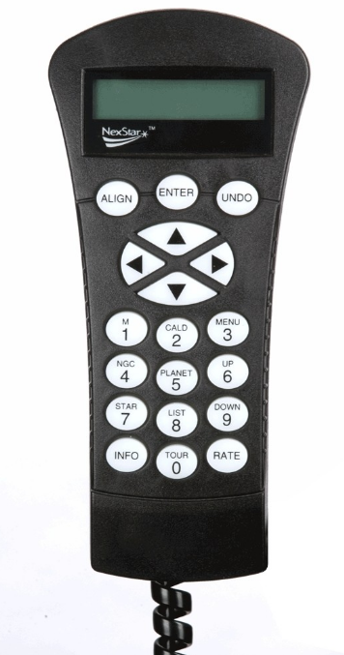
Hand Controller
Almost all selections require pressing enter
Press to undo or go up a level in menus
Manual Slew Buttons, press any of them to abort an automatic slew
Messier objects, follow by 3 digit number
Press to access menus
Solar system objects
Scroll up/down
Press to get basic information on current target
Rate, followed by a number to change slewing speed (1=min, 9=max)
Tour of prime sky objects currently visible

Slide 59
Pick Your Target
For planet/moon/sun*, press “Planet” and use the scroll buttons (6 and 9 to scroll to your target, then press enter
For named stars, press “Star” and scroll up or down to the star you want
For Messier, Caldwell, and NGC objects (nebulae, clusters), press those keys and enter the number for your target, followed by “enter”
Be careful of the moving hardware, especially the counterweight arm, in the dark while slewing
* Do not attempt to view sun without sun filter in place, you must be an advanced user to do this!

Slide 60
At Target
Check your low power eyepiece—often the target will be within the field (Note: low power eyepieces have higher focal lengths!)
  If not, check the finder
  Don’t forget to rotate the dome to where the telescope is pointing
Slow the slew rate, press the “Rate” button, then press 4, 5, or 6 depending on the amount of adjustment required
Use the arrow keys to make the actual adjustment (left-right RA, up-down Dec, RA direction in eyepiece switches with Meridian side) to center the target
If this is the first target of the night, check coalignment between telescope and finder, adjust finder to match telescope if required
Use the same basic procedure to get to any target
  Targets below the horizon will be locked out, we’ll eventually adjust the lower limit to be something reasonable (15° or so)
  Watch for Meridian flip—know what side of the Meridian your targets are on, and try to complete one side of the sky before switching to the other

Slide 61
Available Accesssories
Variety of eyepieces
  Both 2” and 1 ¼”, with 2” to 1 ¼” adapter
Barlow lens
Mallincam hyper color and monitor
APS size color wireless camera and tablet
Hα piggyback telescope
Binoviewer

Slide 62
Lessons Learned from Previous Classes
Aligning to targets that aren’t really the targets they thought they were
  Only realign to targets you absolutely know are correct
Slipping the clutches
  By removing the aperture cover or rotating the diagonal with too much force
Not verifying the alignment between the telescope and finders
Losing alignment between finder and telescope by having the finder diagonal rotate
Not making sure the target is in the crosshairs of the diagonal
Everyone kept thinking the arrow keys are used to move up/down through menus—use the 6 and 9 keys
  The arrow keys are only used to control telescope movement!
Don’t get confused by the E and W on object lists—if it happens, press Menu to make it go away!

Slide 63
Shutting Down the Telescope
Press “Menu”, scroll down to Utilities, press enter
  Scroll down to Home Position, press enter
  Select Go-To home position, press enter
The telescope will slew to pointing north, with the tube up
When done slewing, go back to Utilities, scroll to Hibernate, and press enter
  When the hand controller indicates to, turn off the power at the mount, then turn off the power supply under the pier
Make sure the pier is at its lowest position
Cover the aperture

Slide 64
Shutting Down the Observatory
Use the drill/hook to close the dome slit (clockwise rotation)
  There has been a chronic problem with people not fully closing the slot—we will emphasize this during hands-on training
Turn the dome so the slit is roughly southeast
Power off other electrical equipment, turn off power supply under telescope pier
Put away all accessories, lock up accessory cases
Take a look around, make sure you are leaving things in better shape than you found them in
Make sure log sheet is complete
Turn off lights (including external red light), exit observatory
Make sure door is locked behind you
Take red light off sign at bottom of drive when leaving BBNC

Slide 65
Next…
We’ll go out to the observatory and we’ll walk you through what you’ll need to do
  We’ll try to let everyone do a few things
  We don’t need darkness nor clear skies for this part (just can’t be raining to demonstrate the dome slit)

Slide 66
Skills Demonstration
Must be partly cloudy or better to do this tonight!
Do everything you need to do to prepare for observing
Show you can open/close/rotate the dome
Show you can power up the telescope from the hibernated state, and go to a known target
  Identify the target
  Align the red-dot and finder to the target
  “Sync” the mount to the target
Go to another 2 targets
Hibernate the mount, shut down, close up
We may throw a minor off-nominal situation at you to make sure you know what to do

Slide 67
Questions?

Slide 68
Backup Slides

Slide 69
Typical Amateur Telescope Mounts
Altitude/azimuth
  Mount axes are aligned to your local coordinate system, one produces horizontal motion, the other vertical
  Tracking celestial bodies requires complex movement of both axes
Equatorial fork
  Telescope is balanced between two symmetrical tines of the fork, requires no counter weights, can continuously track across the sky
  RA axis points to the projection of the earth’s rotational axis on the sky, Dec axis is orthogonal
  Takes up more floor space, is subject to more flexure than GEMs
German Equatorial Mount (GEM)
  Telescope is offset from RA axis, and requires a counterweight on the opposite side
  RA axis points to the projection of the earth’s rotational axis on the sky, Dec axis is orthogonal
  Generally better performance for less money than the fork

Slide 70
German Equatorial Mounts
BFRMO’s telescope has a GEM
While German equatorial mounts are common for high end telescopes and astrophotography, many people have not used them before
There are three primary issues to be aware of when using a GEM
  Telescope balance
    Both balance across the RA and Dec axes are critical to proper operation
    To date, our current use of the CGE-Pro shows it is pretty fussy about being properly balanced
  Meridian “flip”
    You cannot continuously track across the meridian, you must eventually let it reorient itself to prevent the telescope from hitting the pier
    I believe the CGE-Pro is limited to about 1 hour of RA past the meridian
    Tries to start from the west when it can (to avoid flipping)
  Targets very close to the north celestial pole
    May be difficult to get to, or require very long slews to go a very short distance over the sky

Slide 71
GEM Issues
Careful balancing is required, and it is easy to get in trouble balancing if you aren’t careful
  Weights can fall off, telescope axes can rotate violently—damaging hardware and causing injury
  We ask that beginner’s not try to balance the telescope (meaning you shouldn’t be doing anything to change the weight on the telescope other than installing/removing eyepieces)
Watch the location of the counterweight shaft during slews—it is very easy to walk in to, causing loss of alignment and possible injury
  If doing a public event, consider putting a glow stick on the end of the shaft

Slide 72
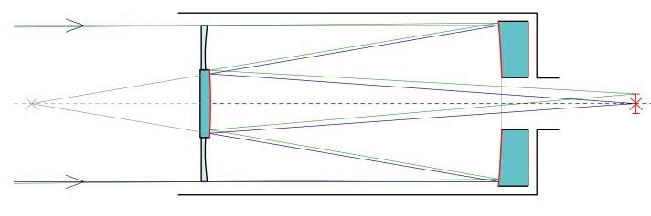
Schmidt-Cassegrain Telescopes
Schmidt-Cassegrain Telescopes (SCT) are catadioptric in design (reflective and refractive elements)
The corrector plate at the front (which you come close to while removing/reinstalling the cover) is by far the most common thing that is broken on them, and is very costly to replace
  Be very careful removing/installing the aperture cover

Slide 73
SCT’s
Are quite compact for their aperture and focal length
Generally have slow focal ratios, typically f/10
  Focal reducers are often helpful with extended objects and astrophotography
Often have stray light issues when observing objects close to the moon
Typically will not give as tight an image as a good APO refractor or Newtonian reflector
  The image won’t “snap” to focus
The corrector plates often dew up
  Since the telescope is in a dome, this is not a common problem for us

Slide 74
APO Refractor’s
Generally have fairly modest sized apertures
Generally have medium-fast focal ratios, typically f/6
Usually have good baffling, minimal stray light issues
Tack sharp star images
  The image “snap” to focus
The lens can dew up, but most have a dew shield
  Again, since the telescope is in a dome, this is not a common problem for us

Slide 75
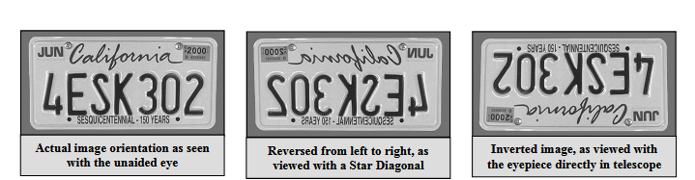
Images
Applies to both the 80 mm APO and the 14” SCT
Illustration from Celestron CGE owner’s manual

Slide 76
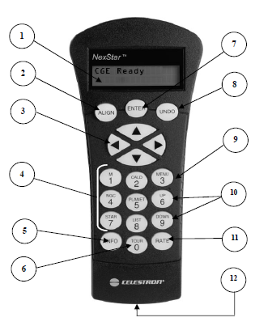
Hand Controller
Liquid Crystal Display
Enter
Align
Undo
Direction Keys
(Slewing Scope)
Menu
(Select Utilities)
Catalog Keys
Scroll Keys
(Menu Items)
Info
(Object)
Rate
(Motor Speed when Slewing)
Tour
RS-232 Jack

